Slide 1



Who wants a glass of wine ?
Let’s convert a virtual No to Yes!

Slide 2


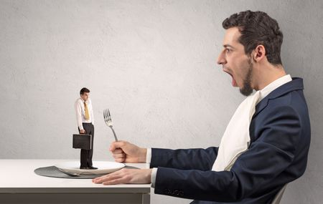
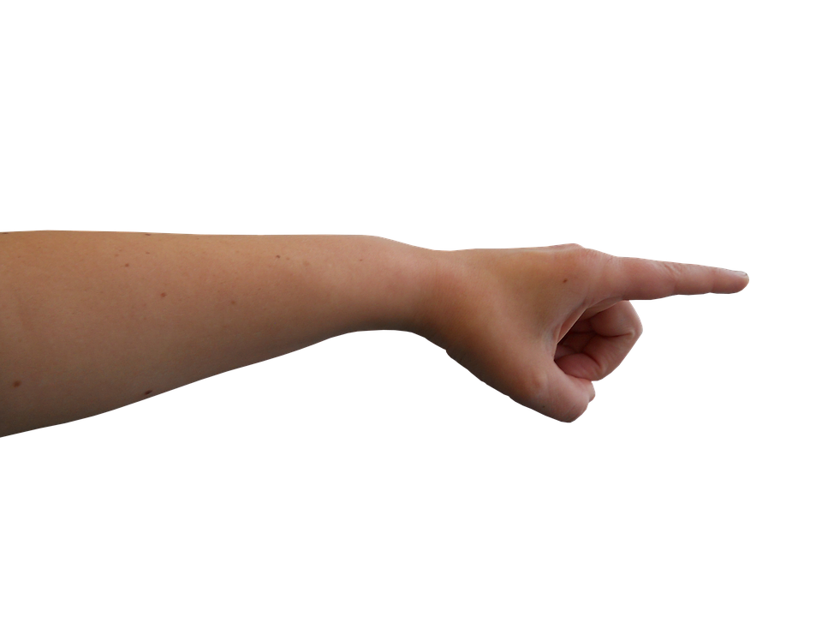
Australian wine industry Recap
The Big guy 70%
You 5%?

Slide 3
Australian wine industry recap (continue)
Supply issues with imported wines and customers wanting to support local wine makers drive an increase in value of wine
Increase in volume of sales due to restricted options to buy in store
Over 70% of global online alcohol sales are from mobile devices, Australia is currently sitting at 20%
Data source: https://www.wineaustralia.com/market-insights/wine-direct-to-consumer-survey-report

Slide 4

Business question
How can we convert more sales online?
Data source: https://www.kaggle.com/datasets/imakash3011/customer-personality-analysis

Slide 5
Dataset & data pipeline
Dataset: Customer personality analysis
2232 Observation and 27 features
Features engineering: Dropping (7), creating (age, range of amount spend on wine, number of campaign responses), encoding
Feature section: applying SelectKBest feature selection
Model analysis using 4 different models
Decision making and recommendation
Data source: https://www.kaggle.com/datasets/imakash3011/customer-personality-analysis

Slide 6
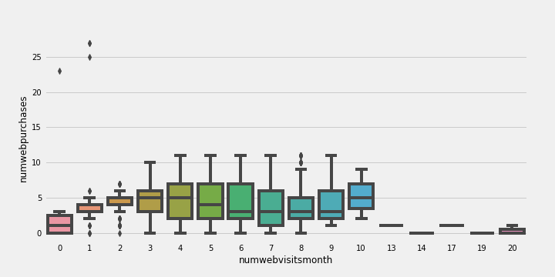
Online activity overview:
Number of web visit per month & Number of web purchase
76% Conversion rate

Slide 7
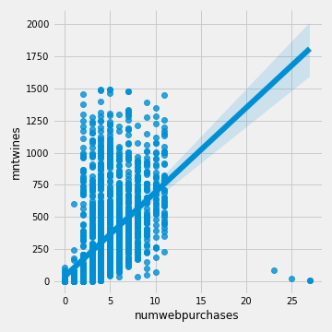
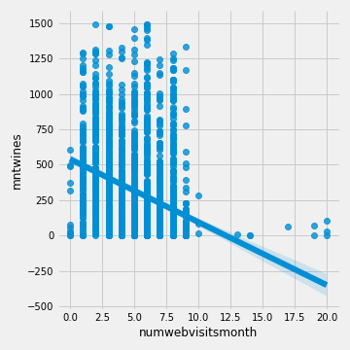
Online activity overview
Web purchase & Wines
Web visits & Wines
Average of $74 per web purchase with average of 5 visits per month

Slide 8
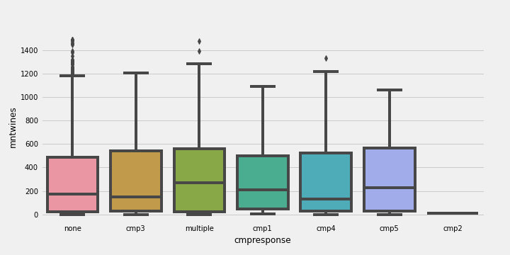
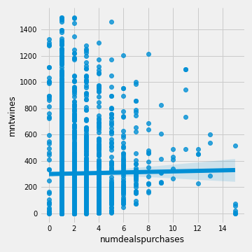
Online activity overview
Response to campaign & amount spend on wines
Wines & Deal purchase
Customer who has no response to campaign has potential to spend more on wines

Slide 9
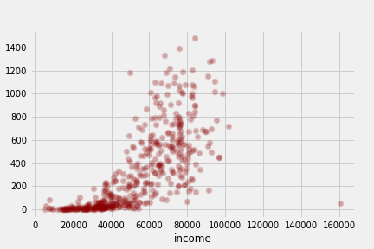
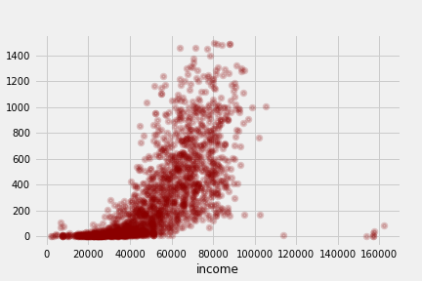
Response vs no response: Income
Response
No response
Majority of customer in Response group earn less than No response

Slide 10
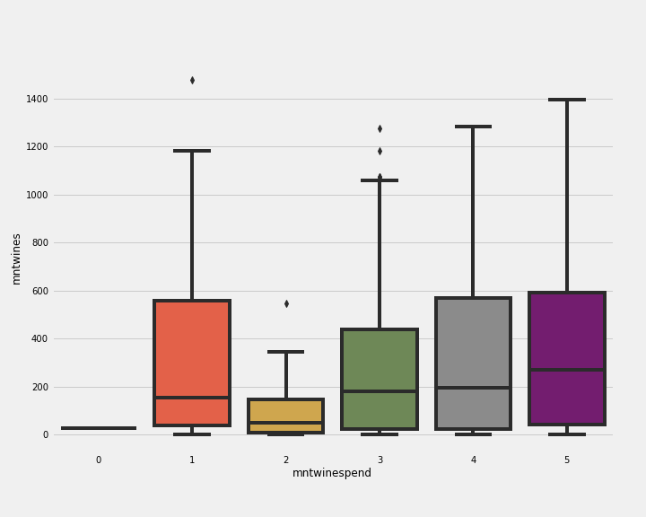
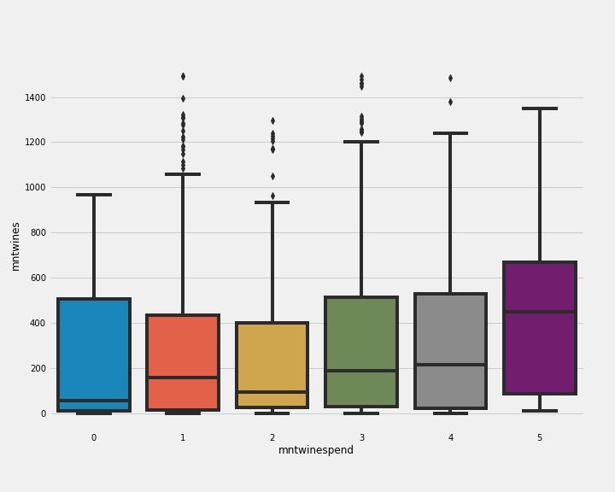
Response vs no response: Amount spend on wines
Response
No response
Customer in No response group spends more on wines

Slide 11
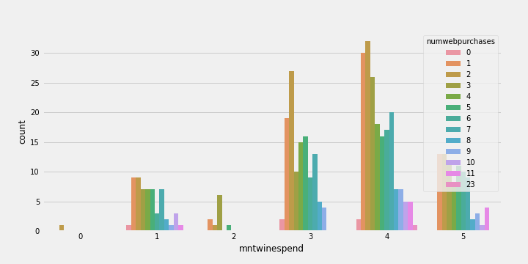
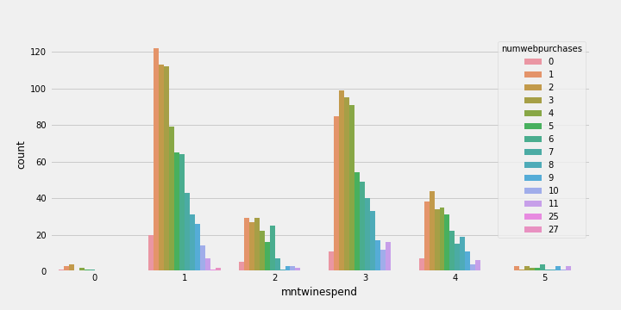
Response vs no response: Web purchase
Response
No response
Customers who respond to campaign tend to spend more on wines.
However, customer in No response group has potential to spend more if we can convert them

Slide 12
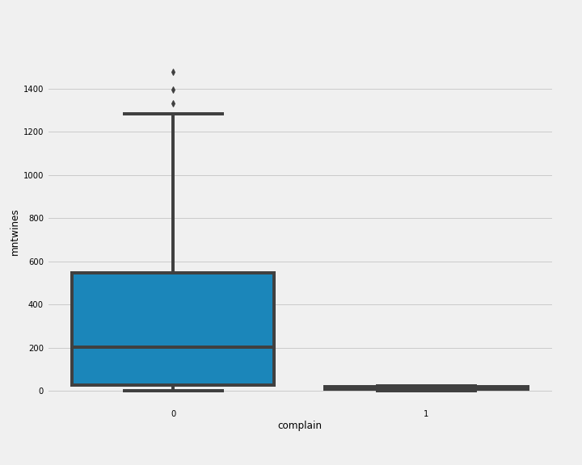
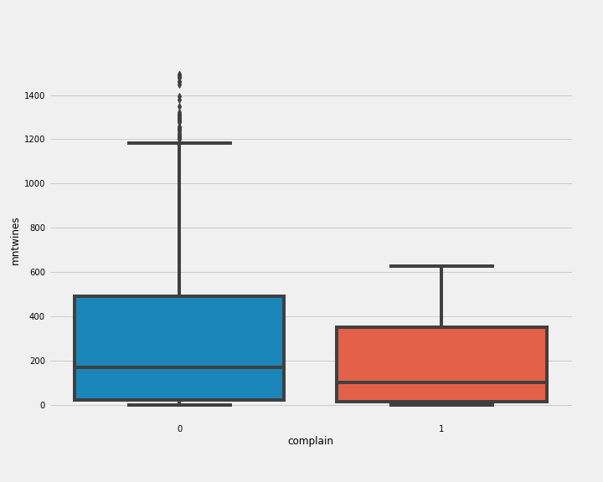
Response vs no response: complain
Response
No response
No response group has significant amount of complain comparing to Response group

Slide 13
Dataset overview for modelling
Dataset split
20% Unseen set
80% Train and test set
Target: Response
Top 5 from SelectKBest features are
Recency
Amount spend on wines
Amount spend on meat products
Age
Group of amount spend on wines(added feature)
*We will also compare results using 13 selected features

Slide 14
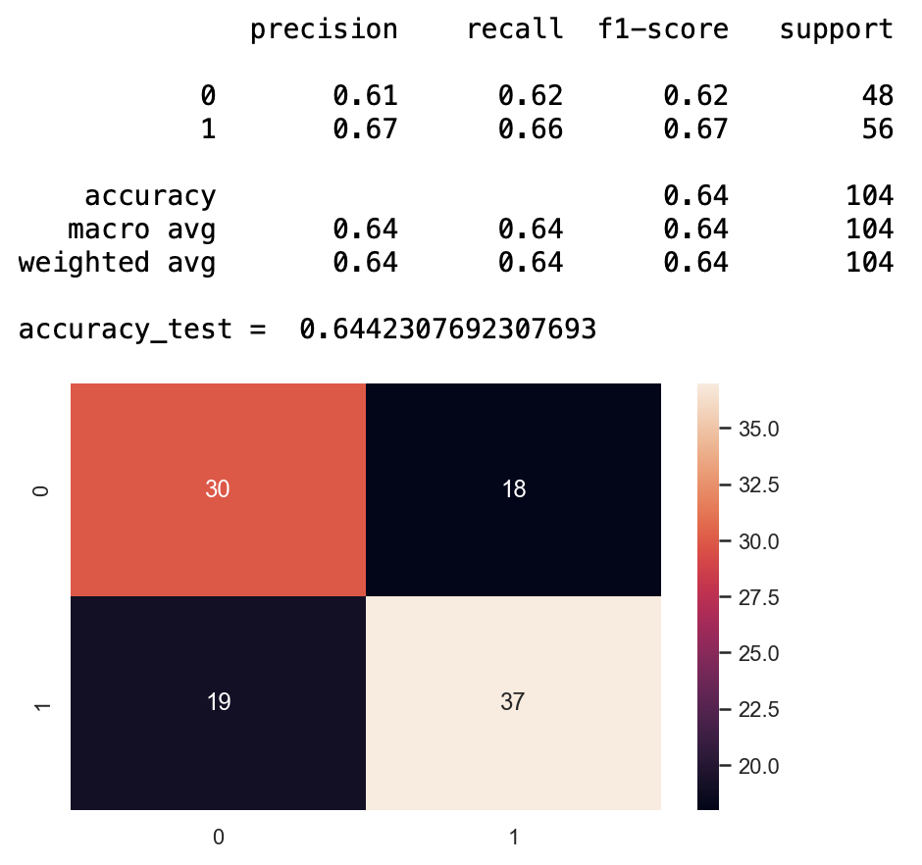
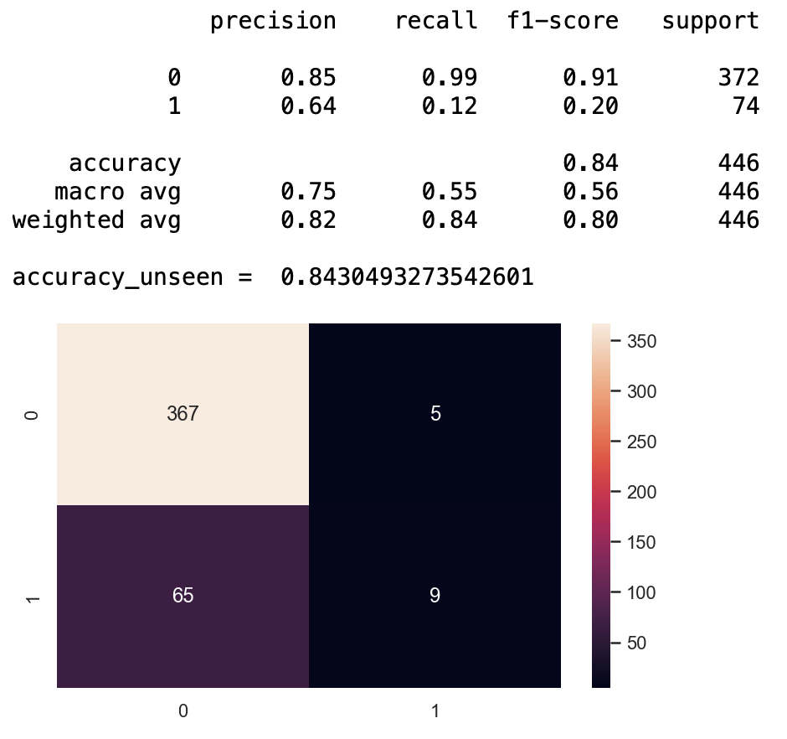
Model results: Logistic Regression
Test set
Unseen set

Slide 15
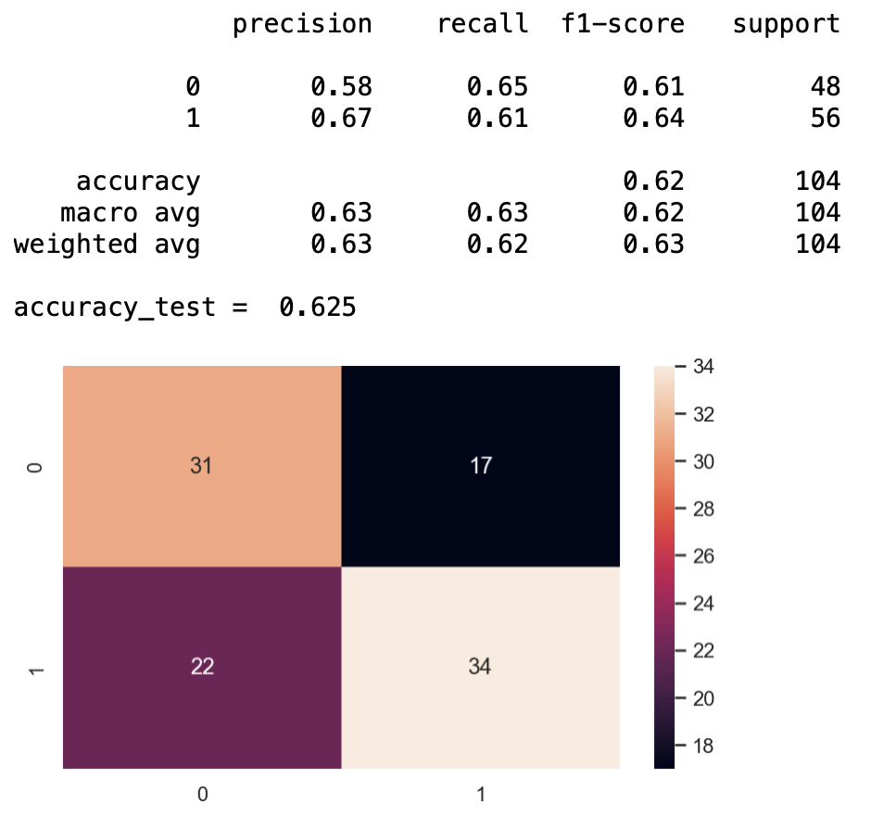
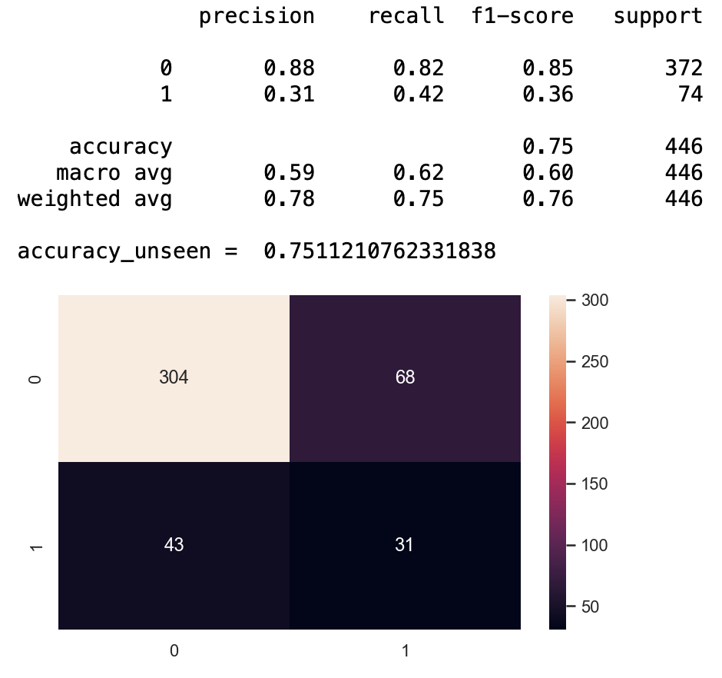
Model results: Support vector machine
Test set
Unseen set

Slide 16
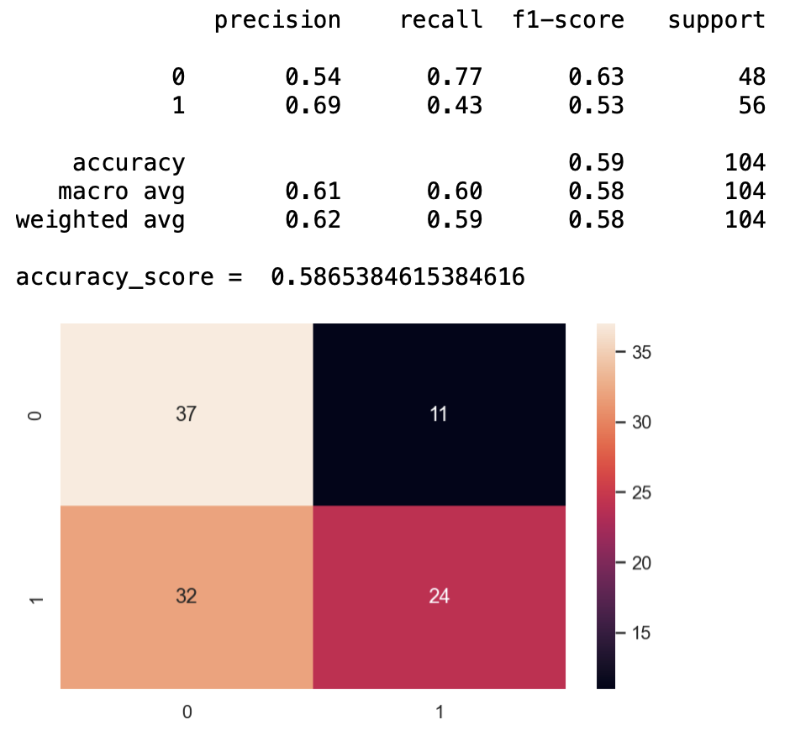
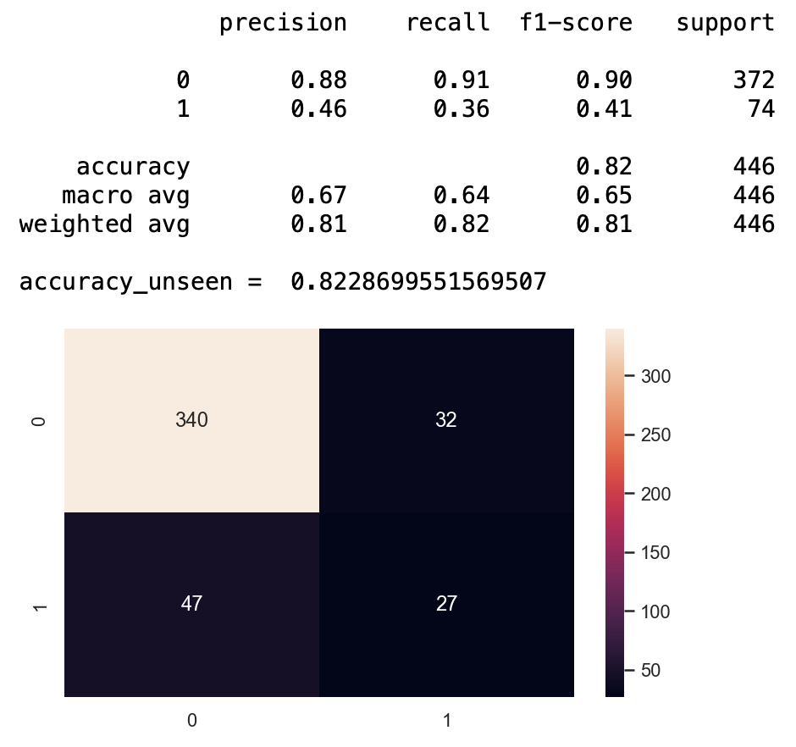
Model results: gaussian naïve bayes
Test set
Unseen set

Slide 17
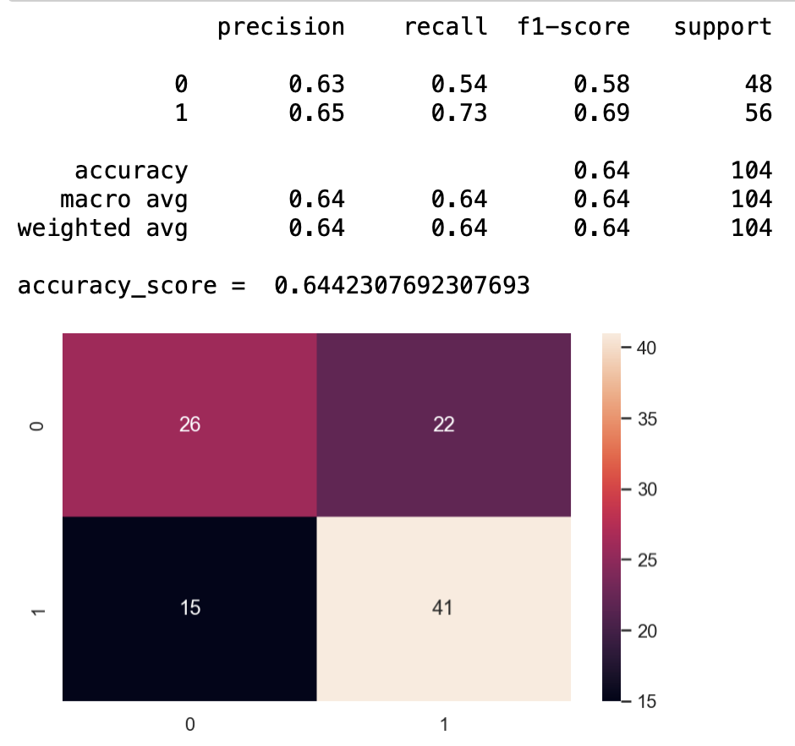
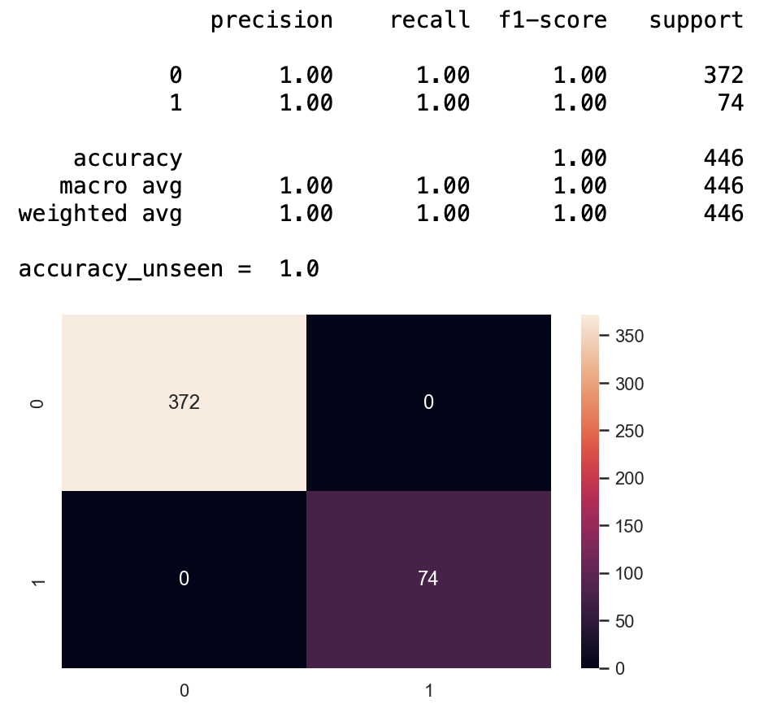
Model results: random forest
Test set
Unseen set

Slide 18
Model results: comparison of using 5 and 13 features
13 Features are
Education
Marital status
Income
Number of kids
Recency
Amount spend on wines, meat and fish products
Number of deal purchase
Web purchase
Campaign responses
Age
Range of their spending on wines

Slide 19
Model results: Summary
Random Forest performs the best when using as many as 13 features and as little as 5 features.
Random Forest is our chosen model for deployment

Slide 20
Plan & recommendation
Addressing customer complains ie delivery concerns, competitive pricing
Promote value added to local business
Offer promotion / personalized campaign
Provide convenience ie. Free delivery, UberDrinks?
Deploy Random Forest Model to identify and improve response rate using methods above
Training and improving model with updated dataset
Data source: https://www.wineaustralia.com/getmedia/85b00eb3-91e6-4c25-9744-43eb07d9558b/Wine-channel-purchase-behaviour-report.pdf

Slide 21

Question ?

